Slide 1
Vector ‘Search’ {
Theory
Analysis
[ Algorithms ]
< Pranshu Gaur – 200703 >
}
Vector Search Algorithms

Slide 2
Table Of ‘Contents’ {
01
02
03
Theory
Analysis
Introduction
Hierarchical Navigable Small Worlds
Locality Sensitive Hashing
04
Product Quantization
05
Optimized Product Quantization
}
06
Scalable Nearest Neighbours
Contents

Slide 3
01 {
[Introduction]
Theory
Analysis
<What are we doing and why?>
Despite significant advancements in audio processing, the search for specific audio content remains a challenge.
Vector Search Algorithms focus on reducing high-dimensional data and performing efficient search for query vectors.
}
Audio Search Engines

Slide 4
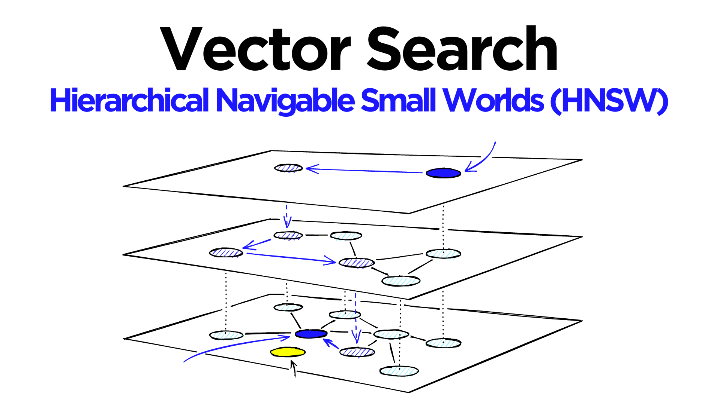
02 Hierarchical Navigable Small Worlds; {
Theory
Analysis
It is a fast and scalable approximate nearest neighbour search algorithm that uses a graph-based structure to perform nearest neighbour search efficiently on large datasets.
Each node in the graph represents a data point and the edges represent the relationships between the points.
The structure is organized into multiple levels, with each level having a smaller number of nodes than the previous level.
When a query is made, HNSW starts at the highest level of the graph and finds the best match, it then proceeds to send the match to the next level until the last layer is reached.
}
Introduction to HNSW

Slide 5
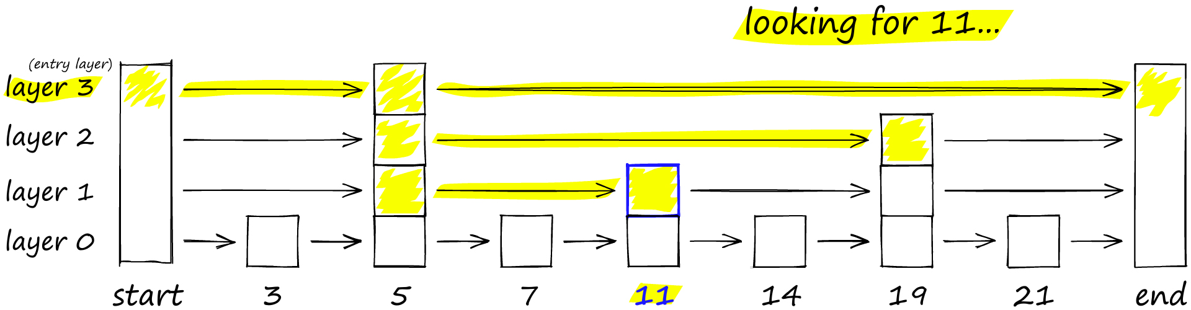
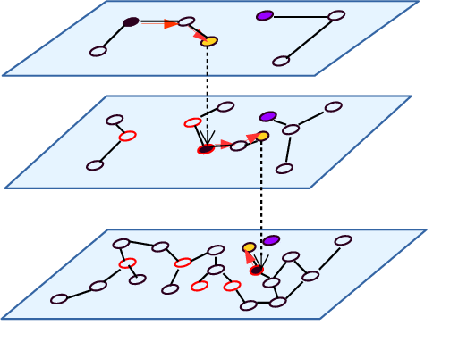
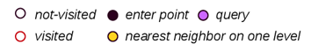
Probability Skip Lists < /1 > {
Theory
Analysis
Allows fast search like a sorted array, uses linked list structure for fast insertion of new elements.
It works by building several layers of linked lists.
As we move down the layers, number of skips decreases.
}
Navigable Small World Graphs < /2 > {
Essentially a proximity graph, but has both short-range links as well as long-range links
Each vertex has links with several other vertices, each vertex maintains a connection list
There exist a fixed entry point through which we start our search
}
Main Concepts of HNSW

Slide 6
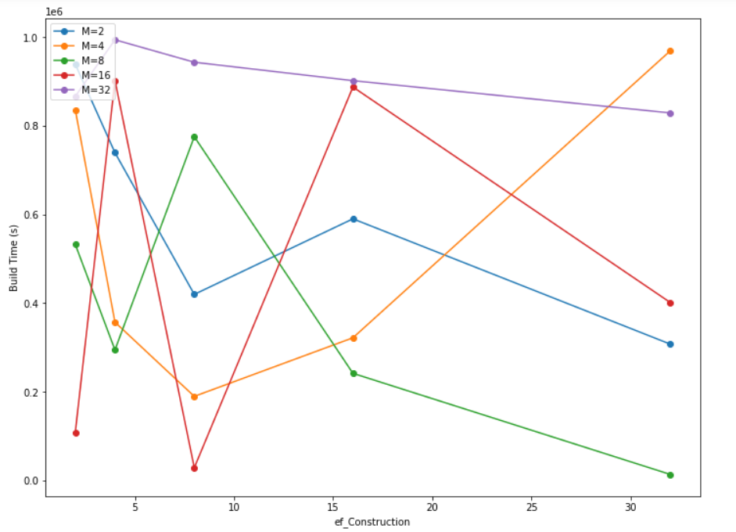
Inferences < /1 >{
Theory
Analysis
With increase in ‘M’, the Average Building Time of Graph increases.
Except for M = 16, in all cases the build time decreases initially and then increases.
}
Search Analysis

Slide 7
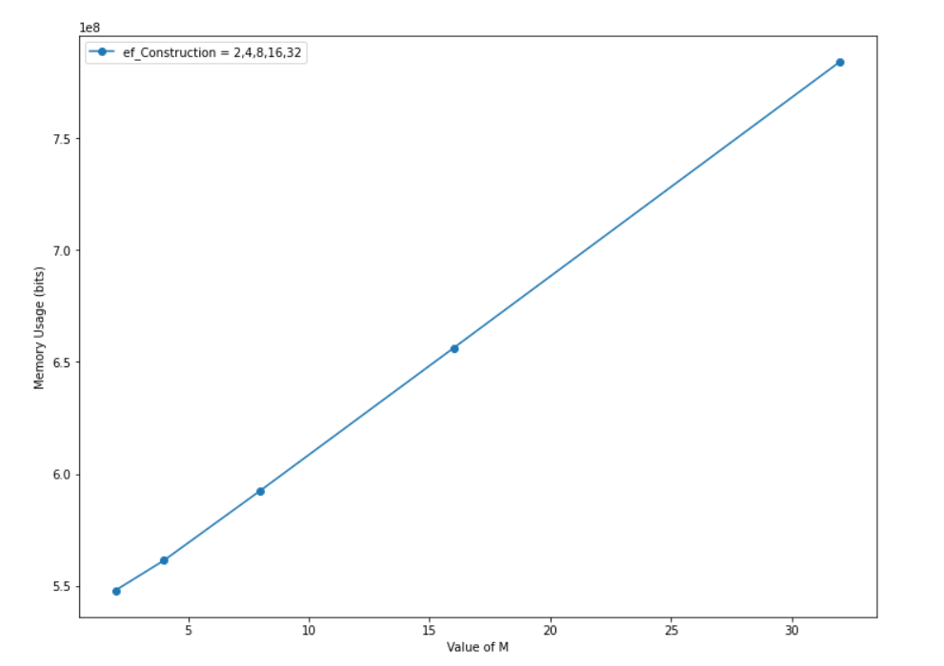
Inferences < /2 >{
Theory
Analysis
With increase in ‘M’, the Memory Usage of Graph increases.
Memory Usage is independent of ef_Construction as well as ef_Search.
The graph is linearly increasing.
}
Search Analysis

Slide 8
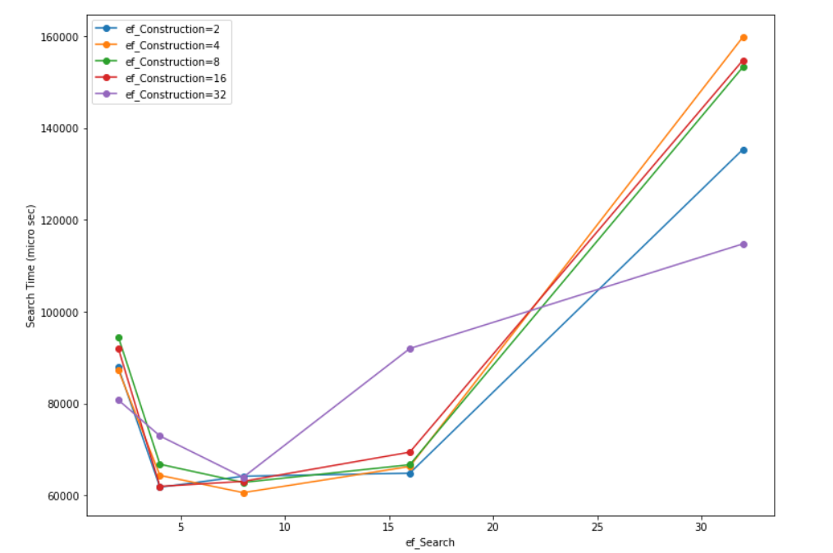
Inferences < /3 >{
Theory
Analysis
Search Time decreases initially with increase in ef_Search and then eventually increases.
M=16 is used in this graph, and ef_Search = 16 gives minima of the graph.
ef_Construction = 32 shows abnormality but takes the least time when ef_Search = 32.
}
Search Analysis

Slide 9
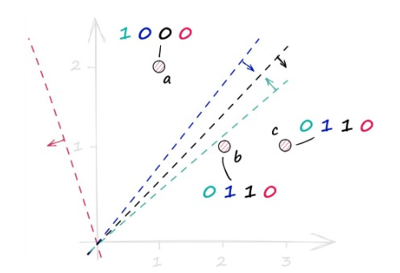
03 Locality Sensitive Hashing; {
Theory
Analysis
It is a family of hash functions that maps high-dimensional vectors to binary codes such that the probability of collision between the codes is higher for vectors that are close to each other in the original space.
It comprises mainly of three methods : shingling, min-hashing, searching.
Shingling < /1 > {
Shingling means converting our d-dimensional data into some k-dimensional one-hot encoding of zeros and ones.
Random Hyperplanes are chosen and the sign of the dot product with the vector is considered.
If the sign is positive, then that hyperplane receives a 1, otherwise it receives a 0.
}
}
Introduction to LSH

Slide 10
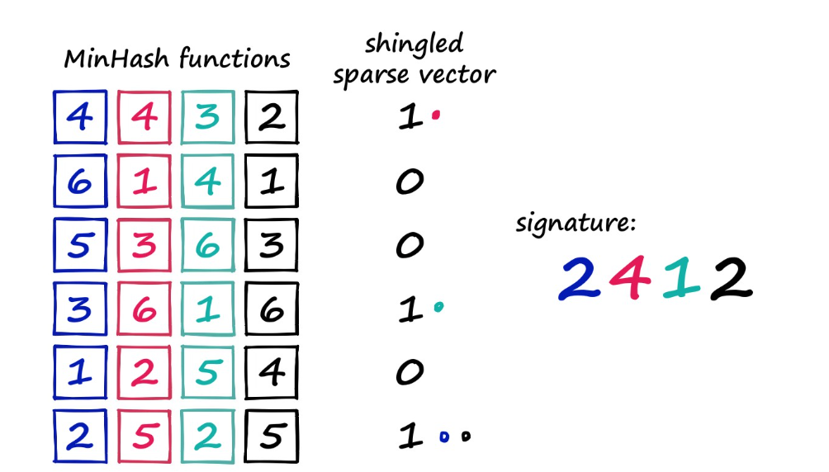
Min-Hashing< /2 > {
Theory
Analysis
In min-hashing, we reduce the dimension of the data to some ~20 randomly generated permutations of the intermediate k-dimensions achieved in the last step.
We look at each permutation and consider the smallest number that is mapped to a 1, this will be our first dimension of the new data.
This process is repeated for all the permutations.
}
Searching< /3 > {
In this, we collect all similar points into a bucket and then reduce over number of points to search.
The similarity is judged on the Jaccard score of the query vector with the vector database.
The similar thing is done for many sets of hyperplanes and the bucket of all hyperplanes is combined.
Each vector in the final bucket is individually matched through the chosen distance metric.
}
Main Concepts of LSH

Slide 11
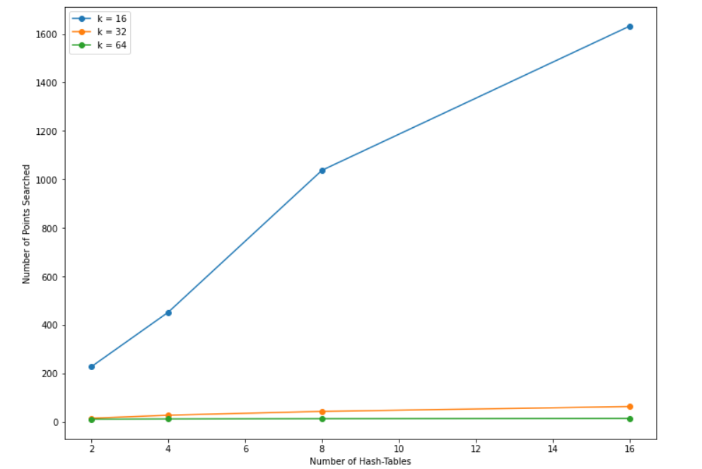
Inferences < /1 >{
Theory
Analysis
With increase in number of hash tables, the number of points searched increases.
As the number of hyperplanes, k, is increased, the number of points searched decreases drastically.
The graph is according to the expectation of the algorithm.
}
Search Analysis

Slide 12
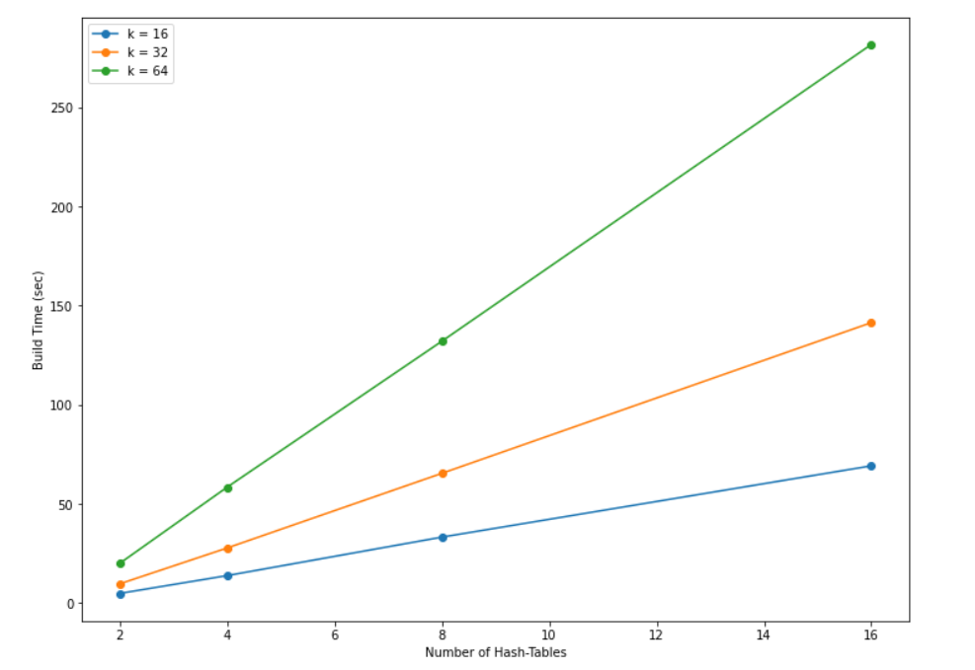
Inferences < /2 >{
Theory
Analysis
With increase in number of hash tables, the build time increases linearly.
As the number of hyperplanes, k, is increased, the build time decreases.
The graph is according to the expectation of the algorithm.
}
Search Analysis

Slide 13
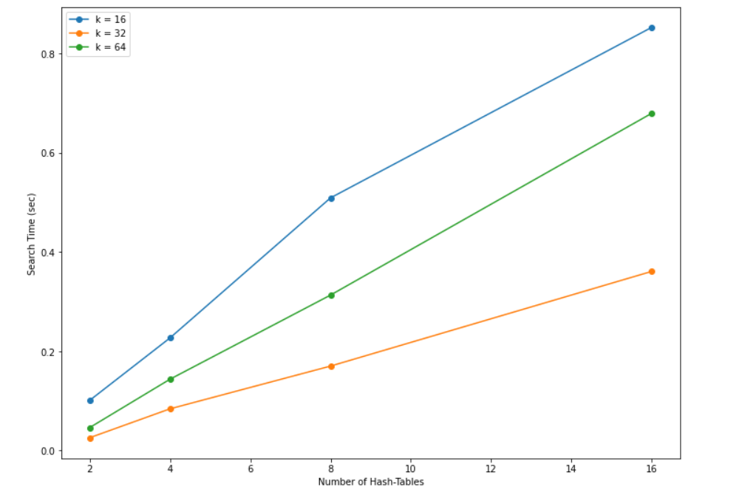
Inferences < /3 >{
Theory
Analysis
With increase in number of hash tables, the search time increases but it is not exactly linear.
As the number of hyperplanes, k, is increased, the search time first decreases and then increases.
}
Search Analysis

Slide 14
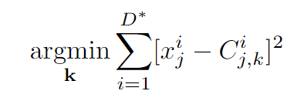
04 Product Quantization; {
Theory
Analysis
High-dimensional vectors are quantized.
Vectors are divided into ‘m’ chunks, called sub-vectors.
k-means clustering applied on each set of sub-vectors to find ‘k’ centroids, C_{j,k}.
A Codebook maintained that contains all the centroids, indexed from ‘0’ to ‘k-1’. The size of the codebook is ‘k’ x ‘m’.
Each vector is represented through encoding formed by the closest centroid of every chunk. This is stored in a matrix called PQ_Code.
L2 norm used as the distance metric.
}
Quantizing the DataSet

Slide 15

Concept < /1 > {
Theory
Analysis
< How to search the query vector? >
Divide the query vector into ‘m’ chunks.
For each sub-vector, we pre-calculate the partial Squared Euclidean distance with all the centroids in its subspace and store it in a matrix, Distance_Table.
We can calculate the distance of the query vector from each vector by summing the partial distances according to the PQ_Code.
Now we have the distances from each vector, we can just sort them and return.
}
Query Search

Slide 16
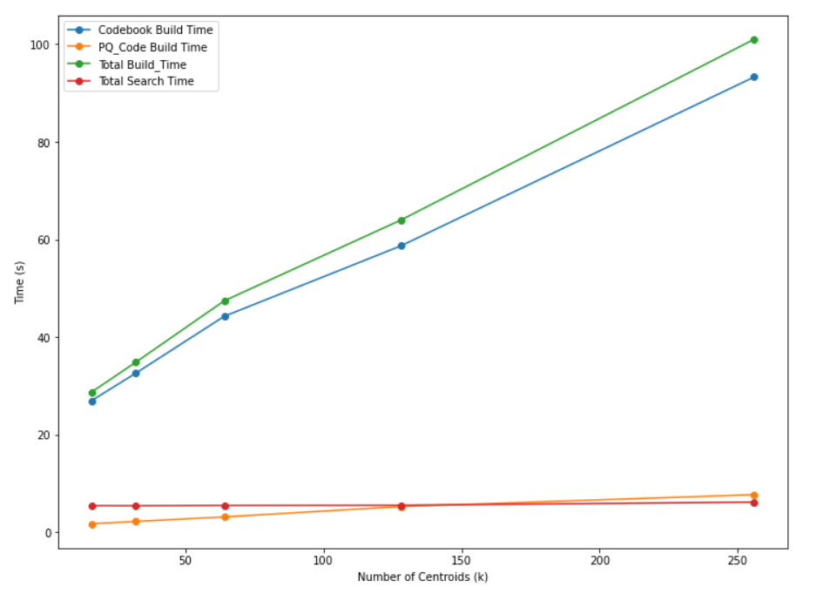
Inferences < /1 >{
Theory
Analysis
With increase in ‘k’, the Building Time of Codebook increased linearly.
The Building Time of PQ_Code is almost constant throughout.
Total Search Time is almost constant because ‘k’ does not play a major role in it.
It returns the sequence of all the vectors closest to the query vector.
}
Search Analysis

Slide 17
05 Optimized Product Quantization; {
Theory
Analysis
Optimized Product Quantization (OPQ) overcomes the challenges of traditional Product Quantization (PQ) by optimizing the codebooks used in the sub-vector quantization process.
There might be data-loss in individual chunks when me divide the original vectors into its sub-vectors.
The variance difference between different chunks may give us the level of information retention, lesser the variance difference, more will be the retention.
}
Need for Optimization of PQ

Slide 18
Concept < /1 > {
Theory
Analysis
< Rotation Matrix for shuffling data points in a vector>
In OPQ, an additional rotation matrix is introduced that rotates the input vectors to a new coordinate system. Let X be the original input matrix and R be the rotation matrix. Then, the rotated input matrix X’ can be obtained as X’ = XR.
The rotation matrix R is optimized to minimize the distortion between the input vectors and their corresponding quantized representations.
This is achieved by solving a matrix optimization problem that minimizes the sum of squared errors between X’ and its quantized representation
}
Rotation Matrix

Slide 19
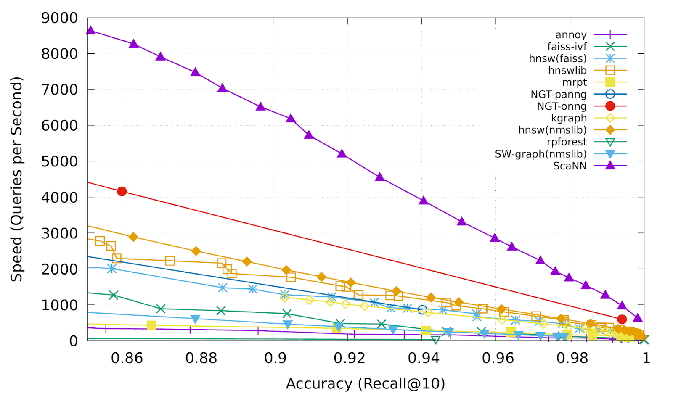
06 Scalable Nearest Neighbours; {
Theory
Analysis
ScaNN (Scalable Nearest Neighbours) is a state-of-the-art algorithm for approximate nearest neighbour search in high-dimensional spaces.
The algorithm uses a combination of hierarchical clustering and randomized search to efficiently find approximate nearest neighbours.
}
Introduction to ScaNN

Slide 20
Hierarchical-Clustering:< /1 > {
Theory
Analysis
The algorithm begins by clustering the data points into a hierarchical structure.
This involves repeatedly dividing the data into smaller clusters until each cluster contains only a few points.
}
Randomized Search< /2 > {
To find the approximate nearest neighbours for a given query point, the algorithm begins at the root of the hierarchical tree and randomly selects a small subset of child nodes to search.
The search is guided by the distances between the query point and the centroids of each child node.
}
Main Concepts of ScaNN

Slide 21
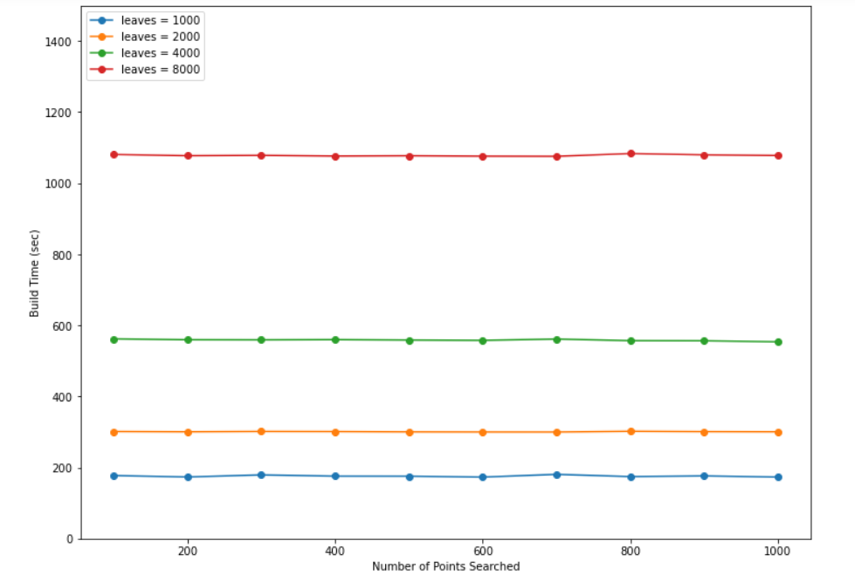
Inferences < /1 >{
Theory
Analysis
As the number of leaves increases, the build time increases significantly.
As the number of data points to search increases, the build time remains almost constant.
The graph is according to the expected algorithm.
}
Search Analysis

Slide 22
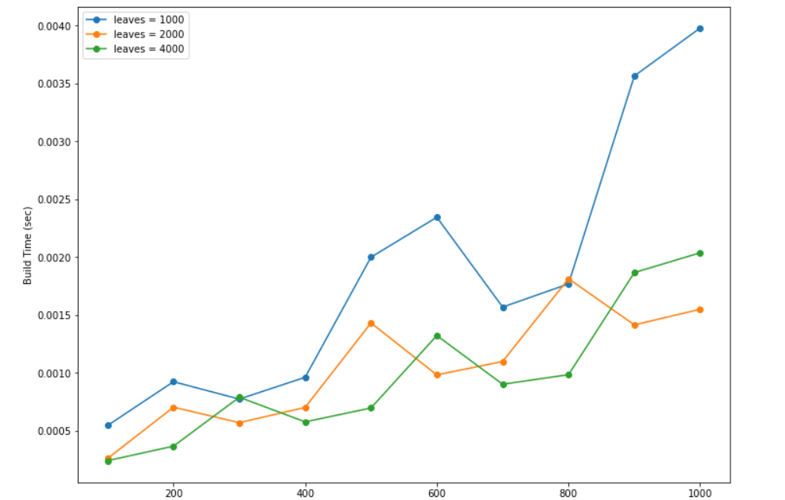
Inferences < /2 >{
Theory
Analysis
As the number of leaves increases, the search time decrease.
As the number of data points to search increases, the search time increases.
The graph is according to the expected algorithm.
}
Search Analysis

Slide 23
Thank { You;
The
End
}
The End

